Slide 1
The IAMSLIC Z39.50 Distributed Library: A Guide to its Content and Search Features

Slide 2
The IAMSLIC Resource Sharing Program
IAMSLIC facilitates international resource sharing among aquatic and marine science libraries and information centers.
In this presentation, users will gain information on how to use the Union List of Marine & Aquatic Serials the IASMLIC Z39.50 Distributed Library (the Z catalog) to identify publications at member libraries in order to request them via interlibrary loan.

Slide 3
Outline
Overview of the Union List of Marine & Aquatic Serials
Overview of the Z Catalog
Searching the Z Catalog Versus the Union List
How to Participate

Slide 4
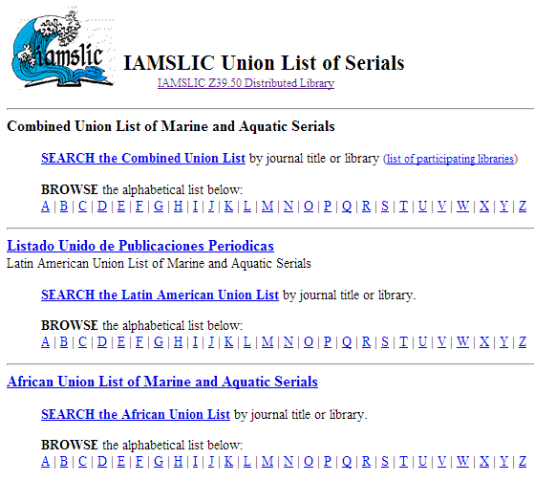
The Union List of Marine & Aquatic Serials

Slide 5
The Union List of Marine & Aquatic Serials
What’s included?
The Union List contains detailed holding information for more than 15,000 serial titles, largely from libraries that do not have online catalogs that can be searched via Z39.50.
The Union List is included as one of the searchable resources when you search the Z Catalog, but it may also be searched separately:
http://library.csumb.edu/iamslic/unionlist/
Several regional lists of serials are also available.

Slide 6
The Z Catalog

Slide 7
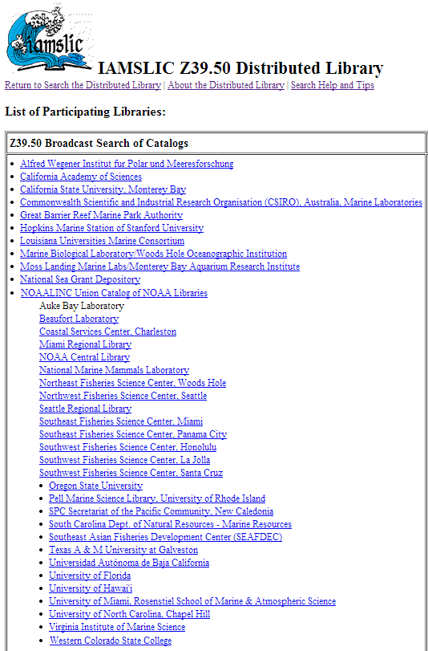
The Z Catalog
Simultaneously searches the online catalogs of each participating institution via Z39.50
all records within the catalog including monographs and serials (print and/or electronic)

Slide 8
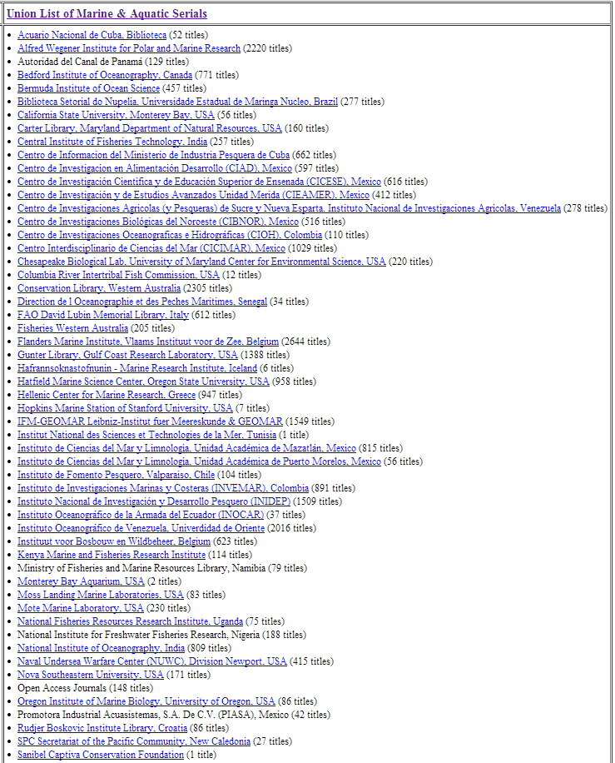
The Z Catalog
Also retrieves serials holdings from the Union List of Marine & Aquatic Serials

Slide 9
Z Catalog Search Options
Search options include:
Title
Keyword
Author

Slide 10
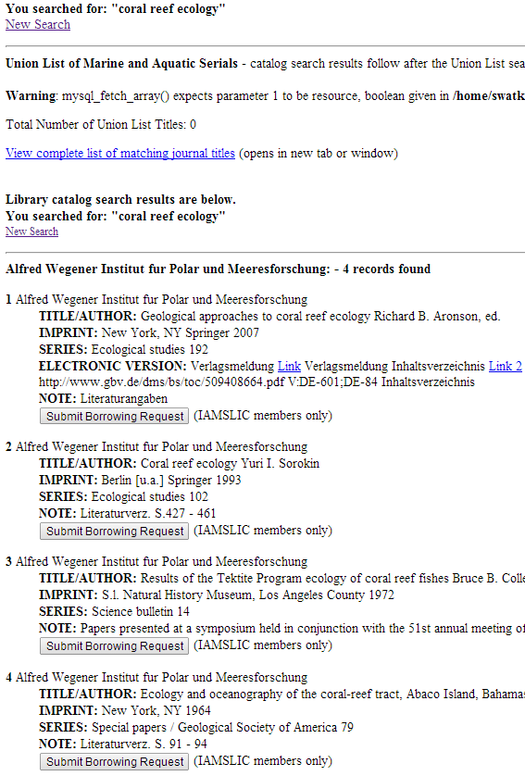
Z Catalog - Title Searches
Some catalogs treat Title searches as phrase searches within the title, others treat them as keyword searches within various title fields.
For example, a search on “coral reef ecology” retrieves titles such as:
Geological approaches to coral reef ecology
Coral reef ecology
Results of the Tektite Program ecology of coral reef fishes
Ecology and oceanography of the coral-reef tract

Slide 11
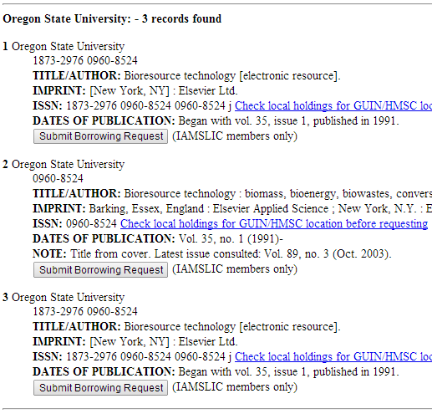
Z Catalog - Journal Titles
Journal titles are also retrieved through a Title search.
Do not use abbreviated journal titles in the search.
To help translate abbreviations into full titles, try JAS: http://www.abbreviations.com/jas.asp

Slide 12
Z Catalog – Author Searches
Use the most unique author surname as your search term.
In most catalogs, Author searches are treated as keyword searches within the various author fields.
Searches that include initials or given (first) names may not succeed.

Slide 13
Z Catalog – Keyword Search
Select unique words from within the title, series, conference, etc. Keywords can also include ISSNs or ISBNs.
If you are unable to decipher the complete journal title, use two or three unique words from the title.
Use for searching a monographic series if it is not found with a Title search.

Slide 14
Z Catalog – Search Results
Search results, if any, from the Union List are presented first.
Results from participants’ library catalogs:
In some institutions, the online catalog is a union catalog of many different branch libraries within the institution. When you search these combined catalogs through the Z Catalog, the local holdings information about which branch owns a particular item is not always available.
Always use the “Check local holdings before requesting” link when the option is offered on the screen.

Slide 15
Z Catalog – Links to E-Pubs
If you see a record that contains a hypertext "Link" in the "Electronic Version" field, click on the link to connect to the full-text document, if it is publicly available.
You may want to search using the search interface of owning library’s catalog to determine more information about the item.
Go to the list of Participating Libraries to connect to the owning library’s catalog: http://library.csumb.edu/iamslic/ill/liblist.php

Slide 16
Searching the Z Catalog Versus the Union List of Marine & Aquatic Serials
For journal articles, the Union List is your best starting point because you can quickly navigate to a particular journal title to see who owns it. Detailed holdings information is available for each library to verify ownership before initiating an interlibrary loan request.

Slide 17
Searching the Z Catalog Versus the Union List of Marine & Aquatic Serials
On the other hand, if you are willing to weed through a list of search results that includes materials other than journals, a search of the Z39.50 Distributed Library will often reveal additional owning libraries for the journal title you’re interested in.

Slide 18
How Can My Library Participate in the Z Catalog?
Library catalogs with Z39.50 server capabilities are invited to participate
Contact Steve Watkins by email:
steve_watkins@csumb.edu
Provide the following information:
Catalog server IP address or Internet name
(e.g., 207.62.129.121 or voyager.csumb.edu)
Z39.50 server port number for incoming queries
(often 210, 7090 for Endeavor, 2200 for SIRSI, etc.)
Internal database name for Z39.50
(Voyager, UNICORN, MARION, INNOPAC, etc.)

Slide 19
How Can My Library Participate in the Union List?
All libraries are encouraged to list their holdings, especially unique, local and regional serial publications.
A simple spreadsheet list of your serial titles and holdings may be submitted for addition to the Union List.
Alternately, a set of Web-based forms will let you:
Add your library’s serial holdings to existing records
Enter new journal titles not already in the Union List
Edit or delete your holdings to reflect local changes
Contact Steve Watkins by email for more details:
steve_watkins@csumb.edu

Slide 20
Where to Get More Information
For more information about searching the Z Catalog or the Union List, contact the chair of the IAMSLIC Resource Sharing Committee http://www.iamslic.org/index.php?section=50
To find out more about becoming a participating library through either the Z Catalog or the Union List, contact Steve Watkins by email: steve_watkins@csumb.edu
About the IAMSLIC Z39.50 Distributed Library: http://library.csumb.edu/iamslic/ill/

